Slide 1
Resume and application process
Resume, cold email, referrals, job boards, remote jobs
30dayscoding.com

Slide 2
Free resume tool
https://resumebldr.vercel.app/

Slide 3
Watch the videos
https://youtube.com/playlist?list=PLxbAS7NVaSZIgqpVNyOA0_ftJN9i1Mls_&feature=shared

Slide 4
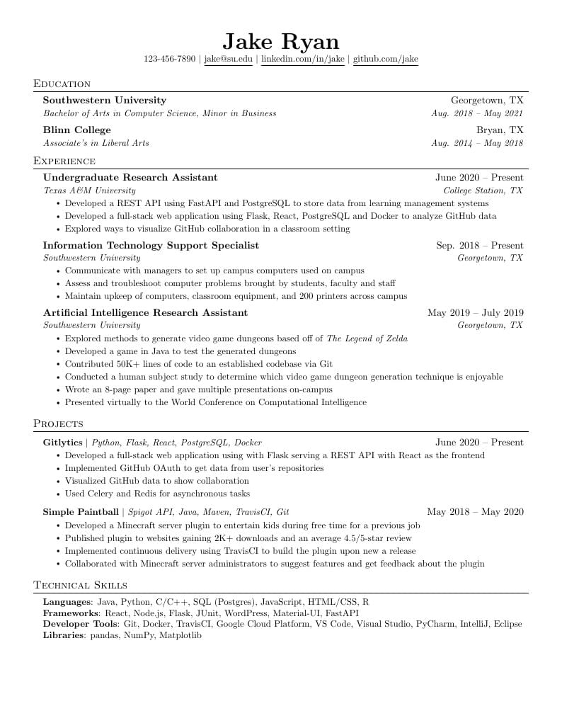
Jake ryan’s resume template
Use this template
https://www.overleaf.com/latex/templates/jakes-resume/syzfjbzwjncs
4 sections
3-4 points
Live links
Github links
NO certificates
No bullshit
Nothing older than college unless super important
DON’T JUST FILL in
Keep it relevant

Slide 5
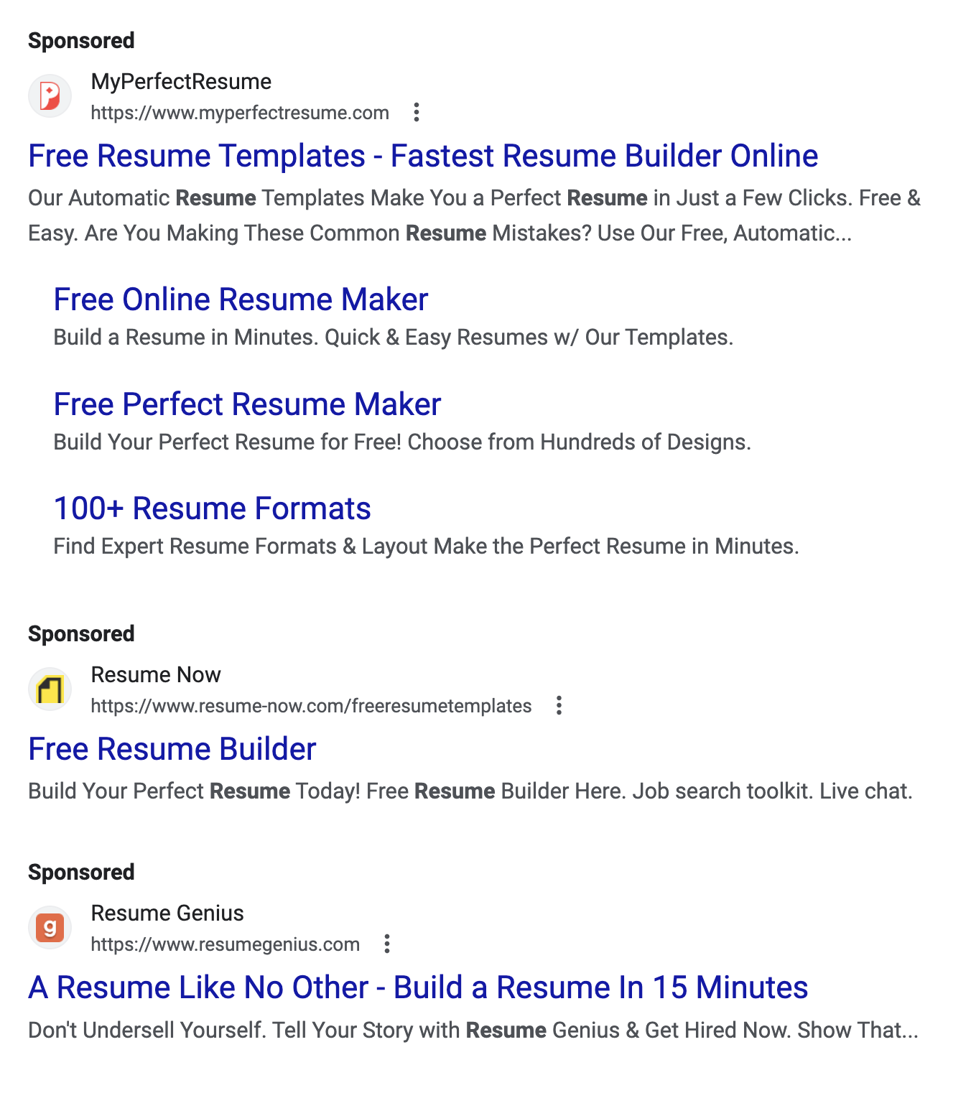
STOP SPENDING HOURS ON TOOLS
Keep it simple
Simple english
Simple points
Learn the basics
The harsh reality is that no one is going to read your resume unless you have something very very impressive

Slide 6
Main points
No summary or certificates
Add skills and keywords - ATS
Think like ATS and not like a recruiter
No recruiter has time for you
Think of bullet point structure and not paragraphs
More numbers and actionable items
More ‘valuable’ things
Bring unique things in your resume
Do not waste all your time
Make projects and add those

Slide 7
Everything you need!
Stop looking for AI tools or templates
Make a simple resume and start applying
You are not getting opportunities because of your projects, not because your resume is “bad”
Just use the template and work on things that matter
Projects + DSA = 99% of your job application
So move on from the fucking resume PLEASE.

Slide 8
Cold emailing and networking
Coders, freelancers, indie hackers, sellers, etc.
30dayscoding.com

Slide 9
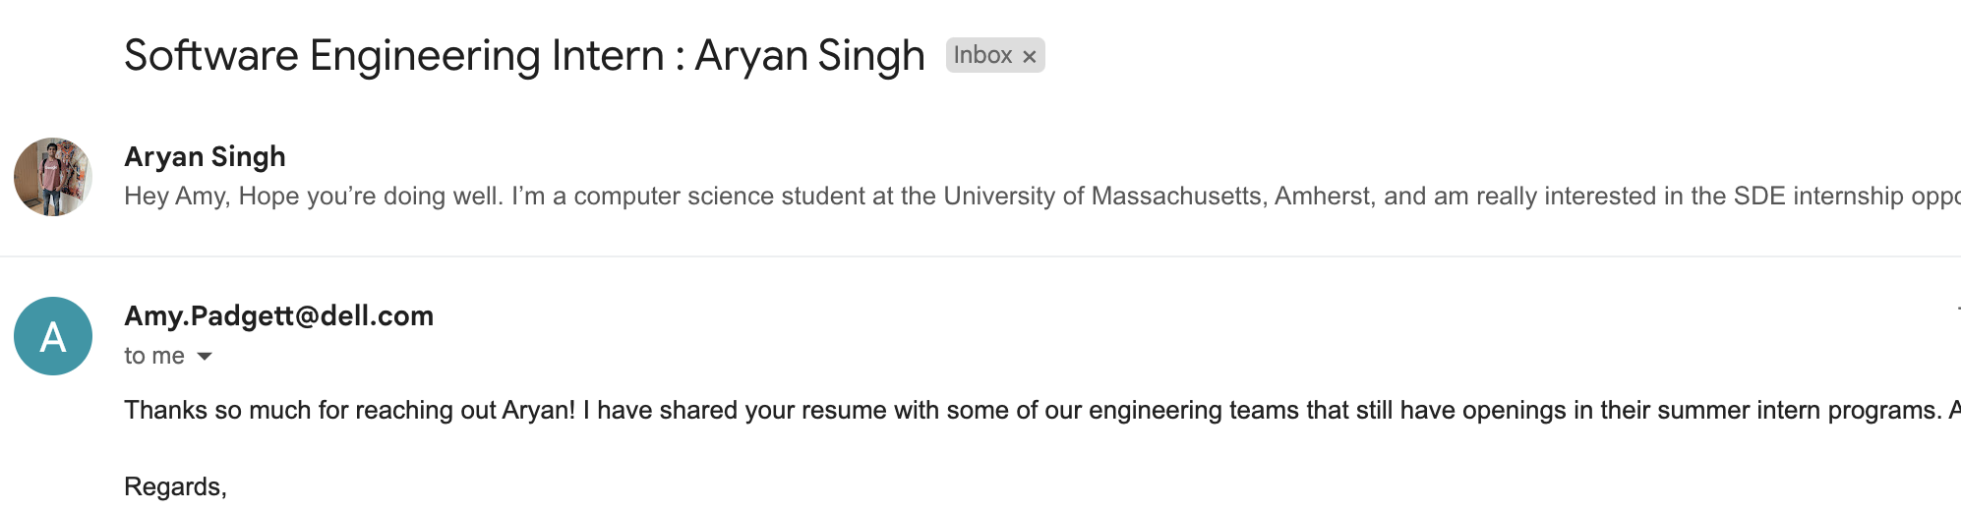
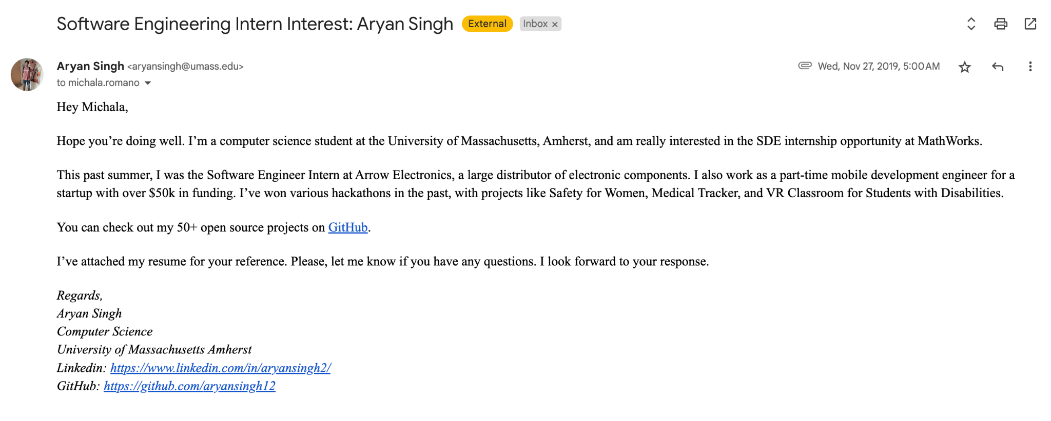
Normal email + emailing when you have another offer
Use the offer
Use the details
Use the tricks
Fasten the process

Slide 10
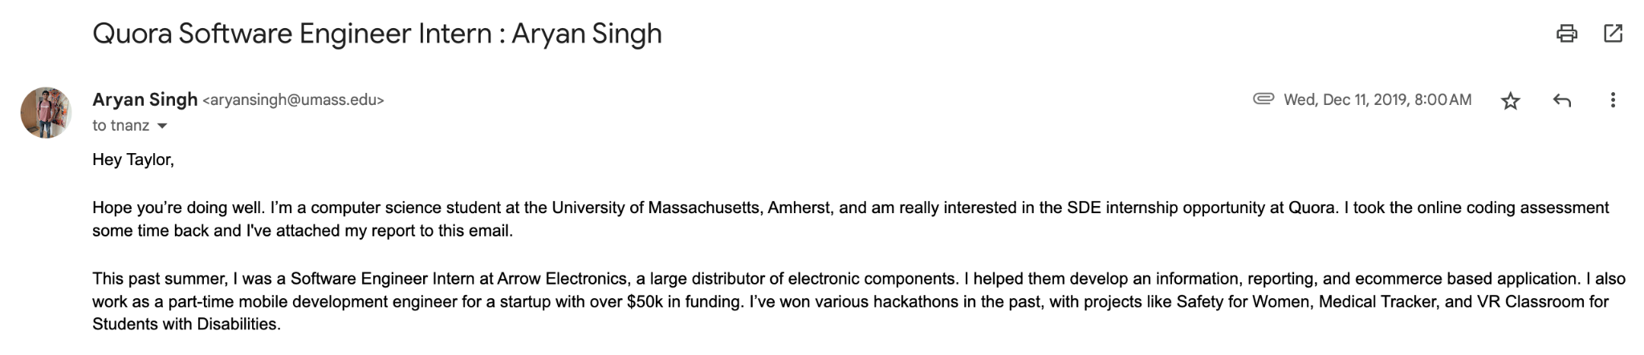
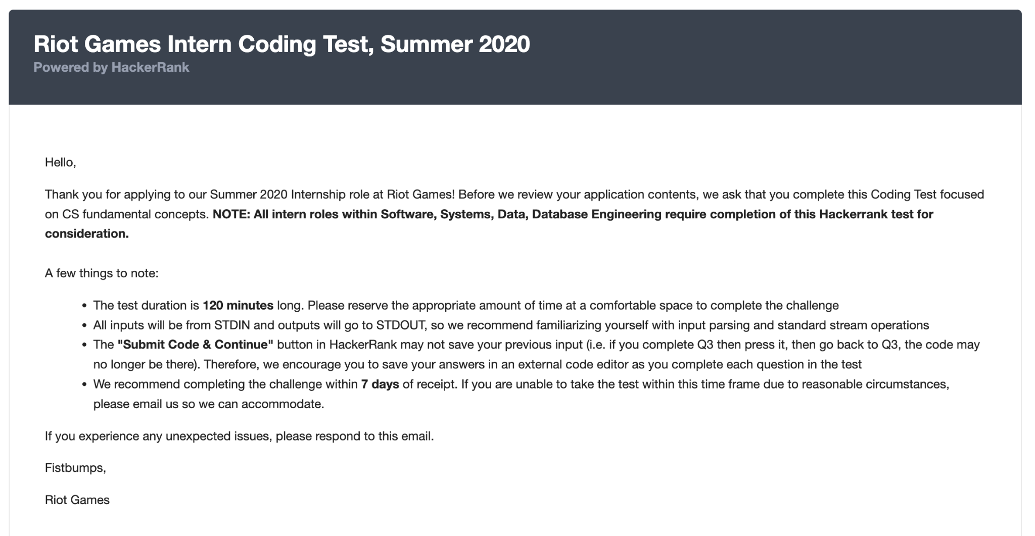
Heading
Description
Test details
Test results
Aim of the email
Result of the email
Keep it simple
Provide value
Concise

Slide 11
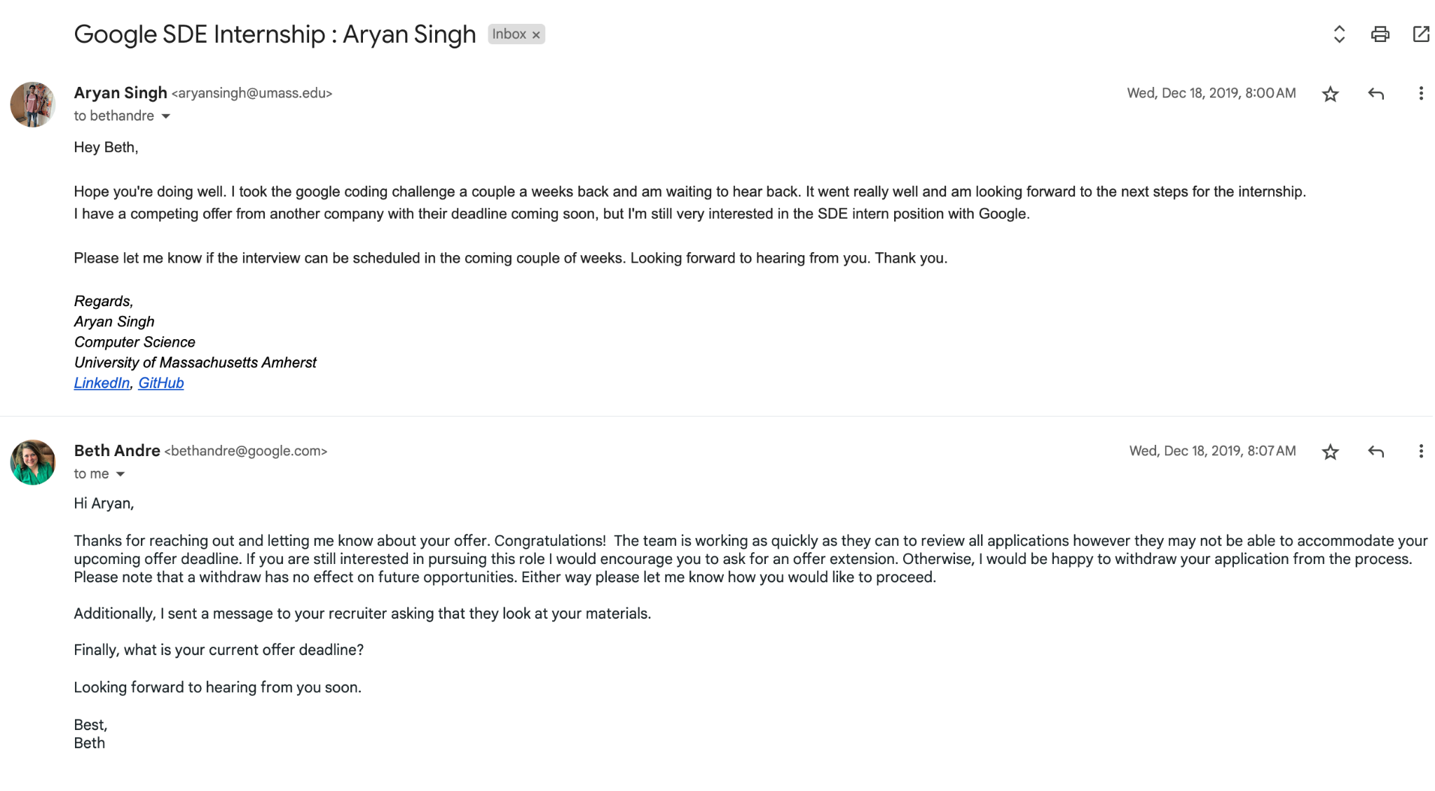

Slide 12
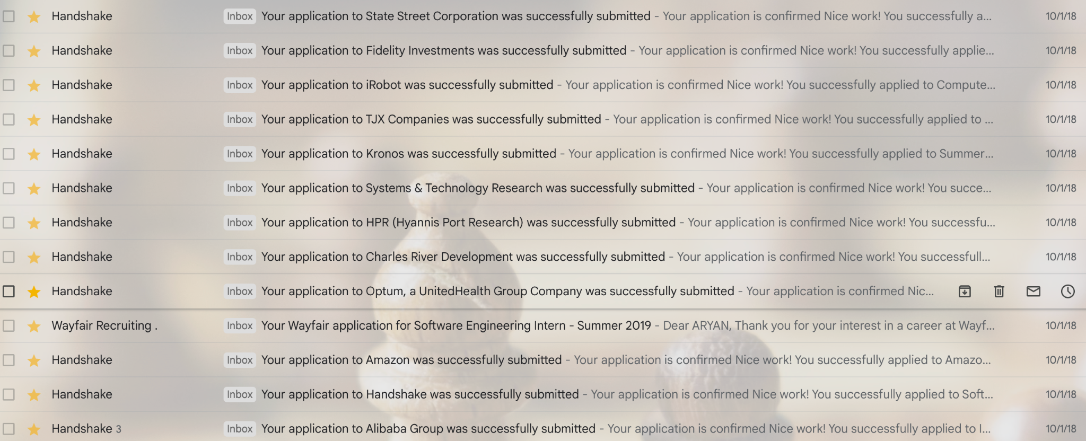
Using a software tool like indeed, handshake, etc is NOT A GOOD PRACTICE.
Look at this example
10000s of people are applying this way
Very slow and outdated

Slide 13
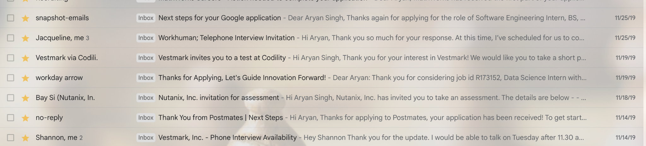
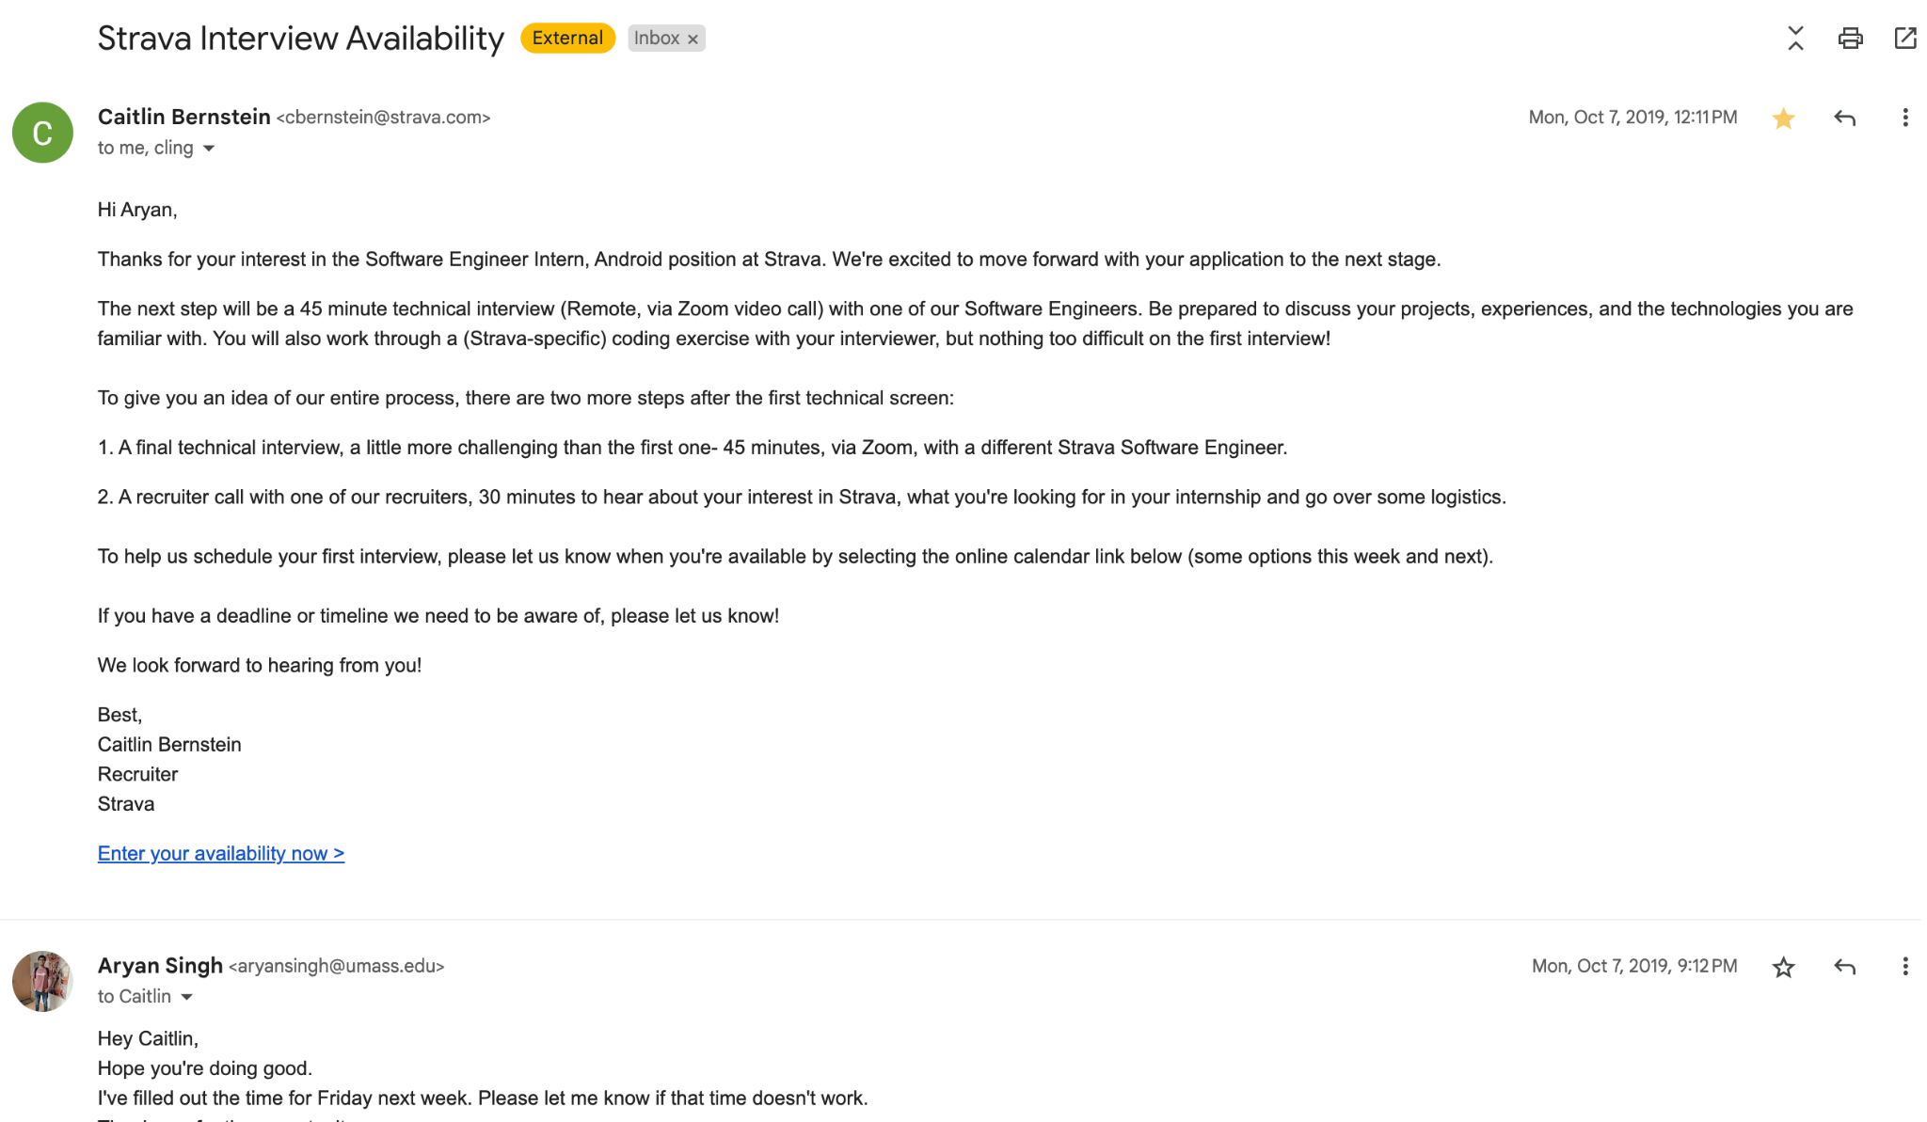
Don’t stop at 1 email
Email 100s of recruiters
Ask for their calls and numbers
Schedule a call if possible
Ask for multiple recruiters
Acceptance rate is usually low

Slide 14
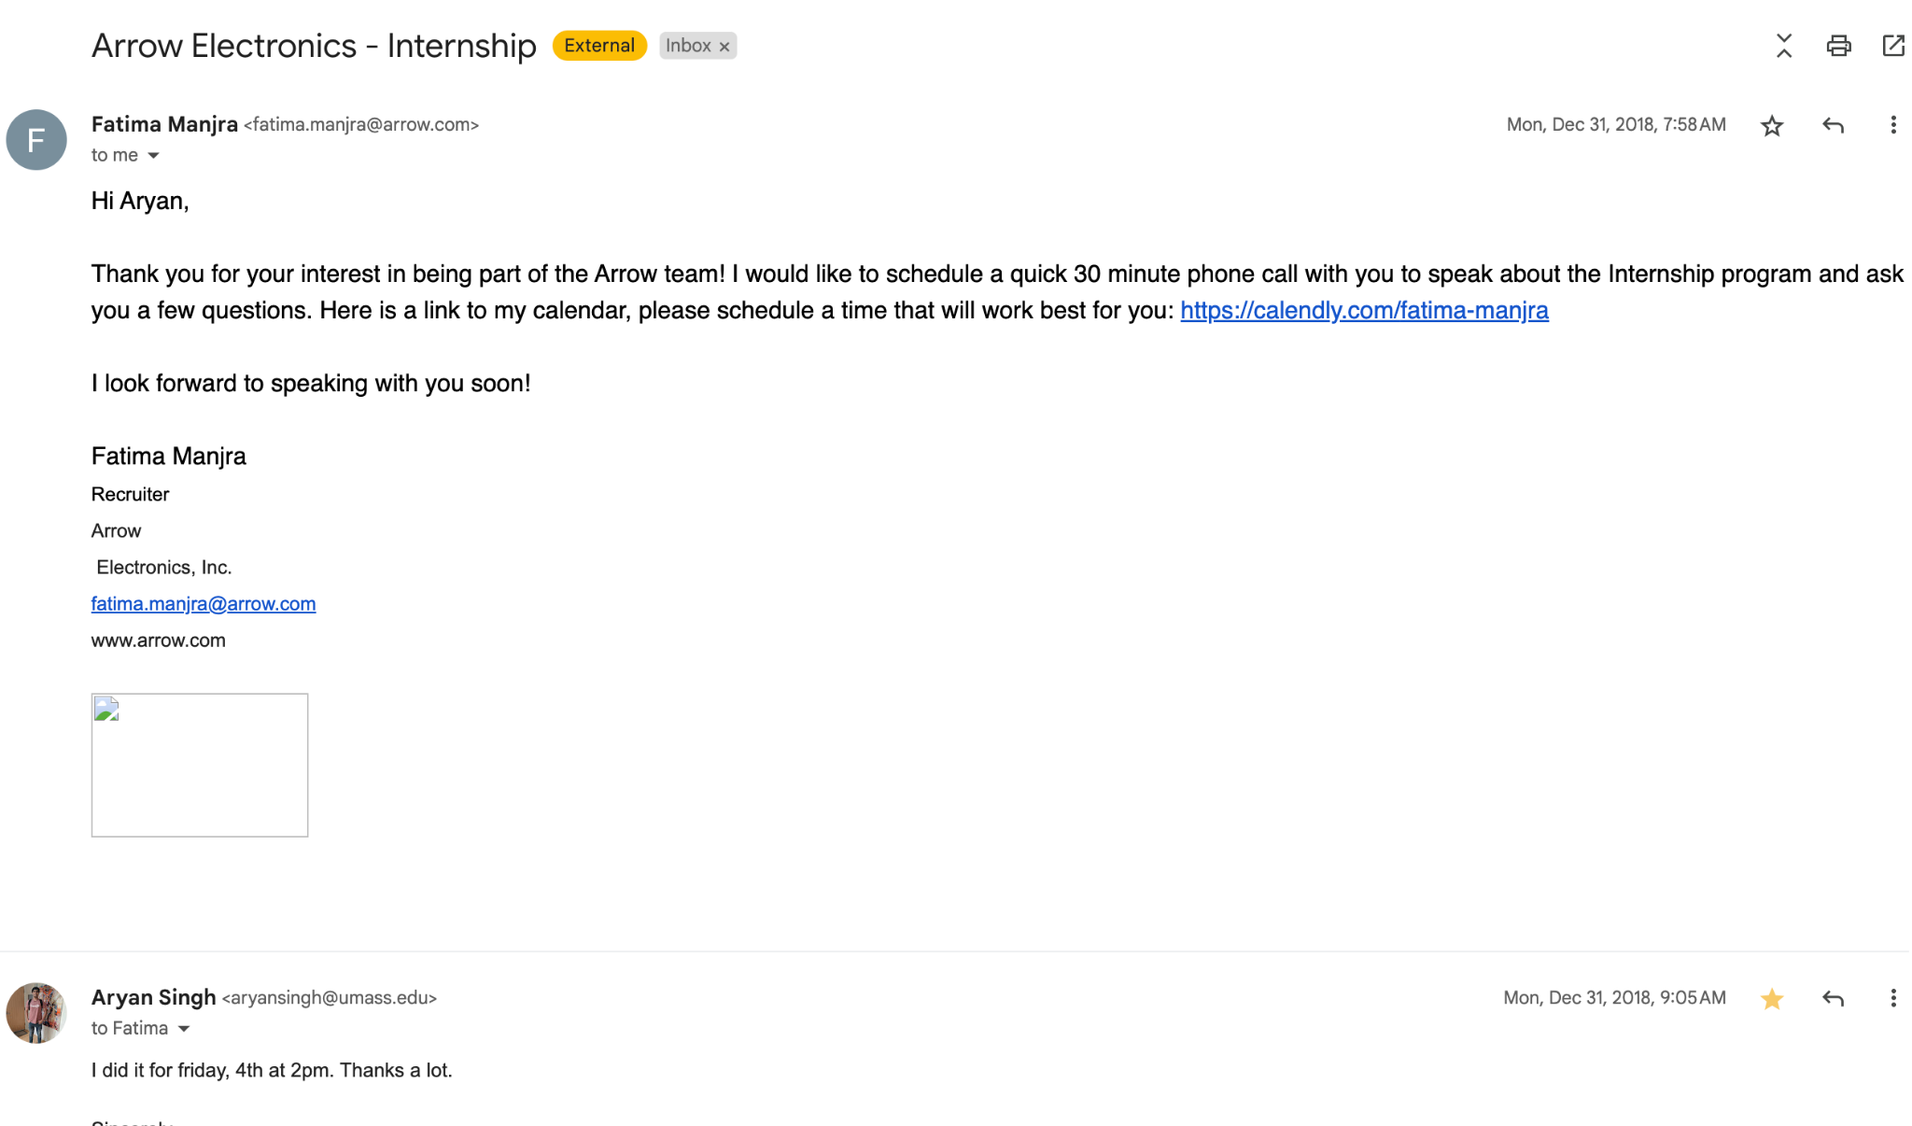

Slide 15
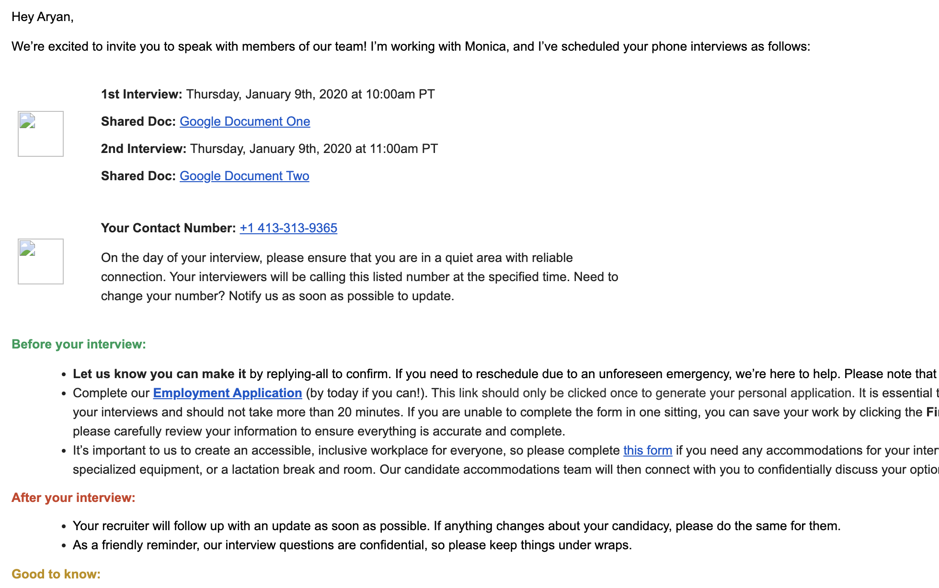
Test yourself with this email response
How will you reply
What will you say
Think about:
What do we want next
Simple and straightforward
Good n bad examples

Slide 16
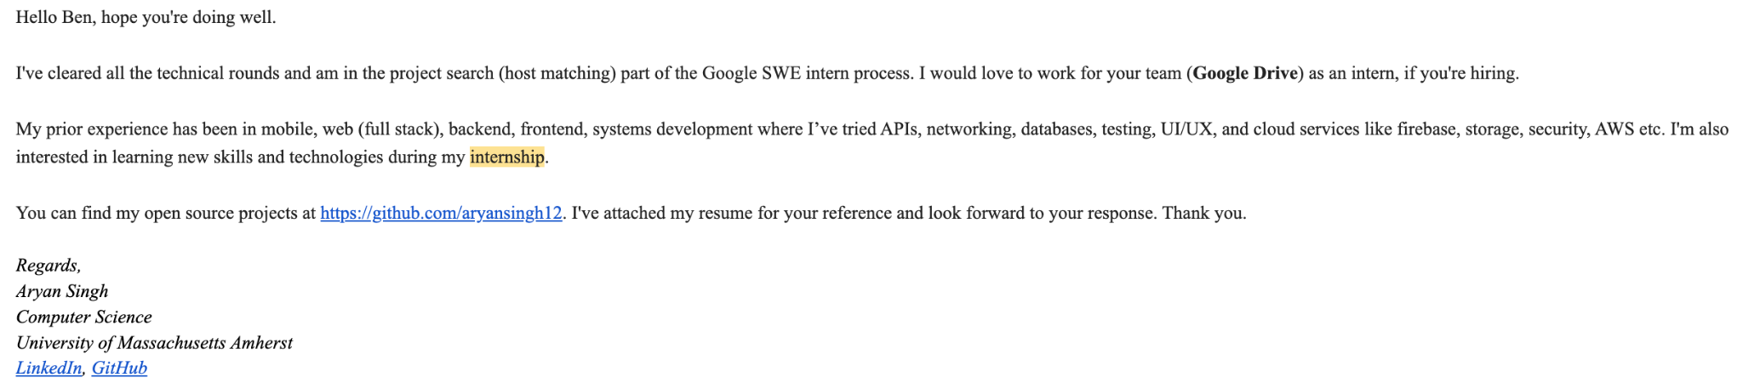
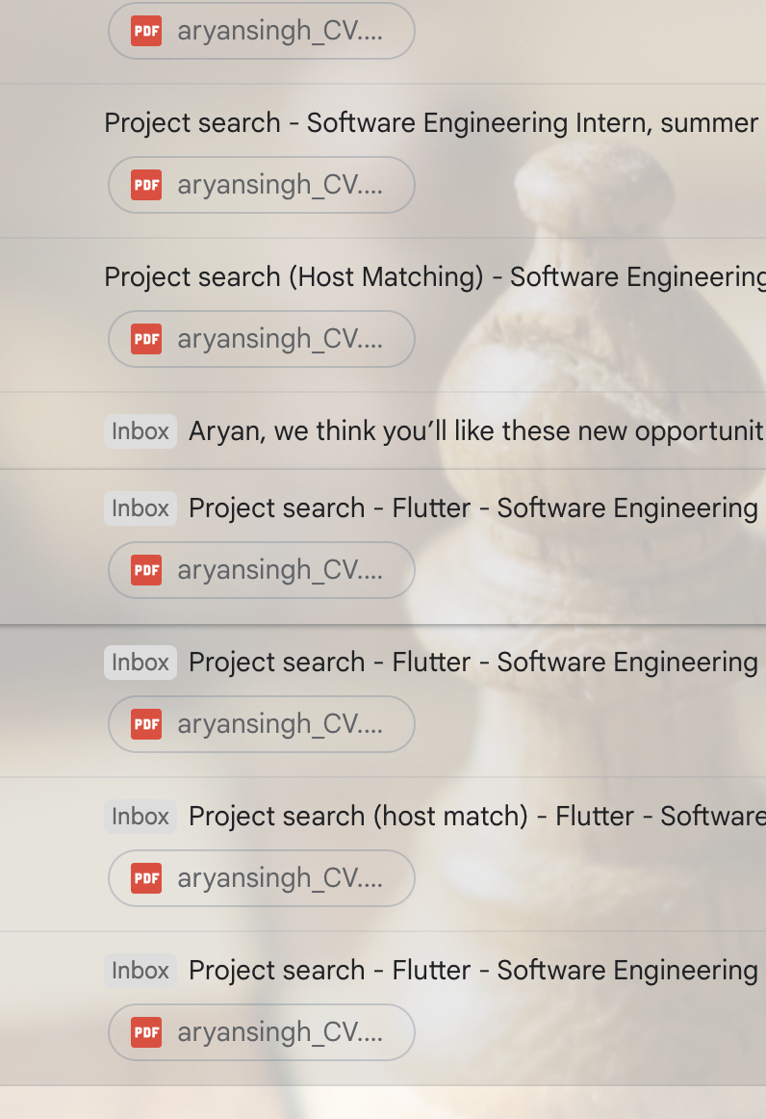
My email for TEAM MATCHING at Google
After my selection
To find a team
Email 50+ people
So many people wait and get rejected in this round. This is how you become better than others.

Slide 17
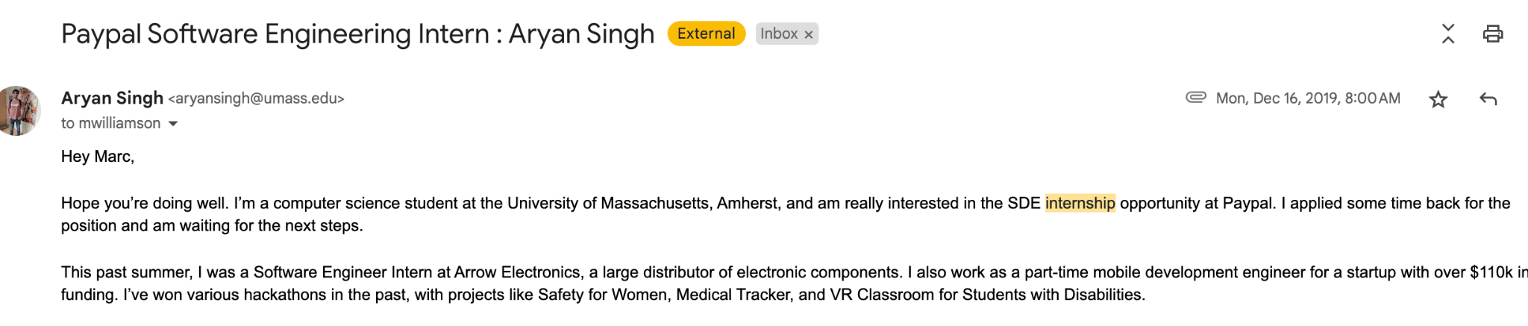
“Applied sometime back”
Revisit the emails
Email them again
Ask for feedback
Ask for updates
Ask for timelines

Slide 18
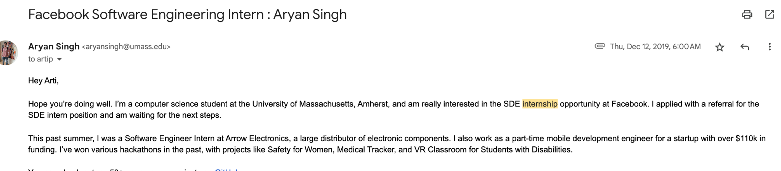
“I’ve applied with referral already”
Tell this to recruiter
Don’t wait and watch
Alert them before others
You need very STRONG POINTS

Slide 19
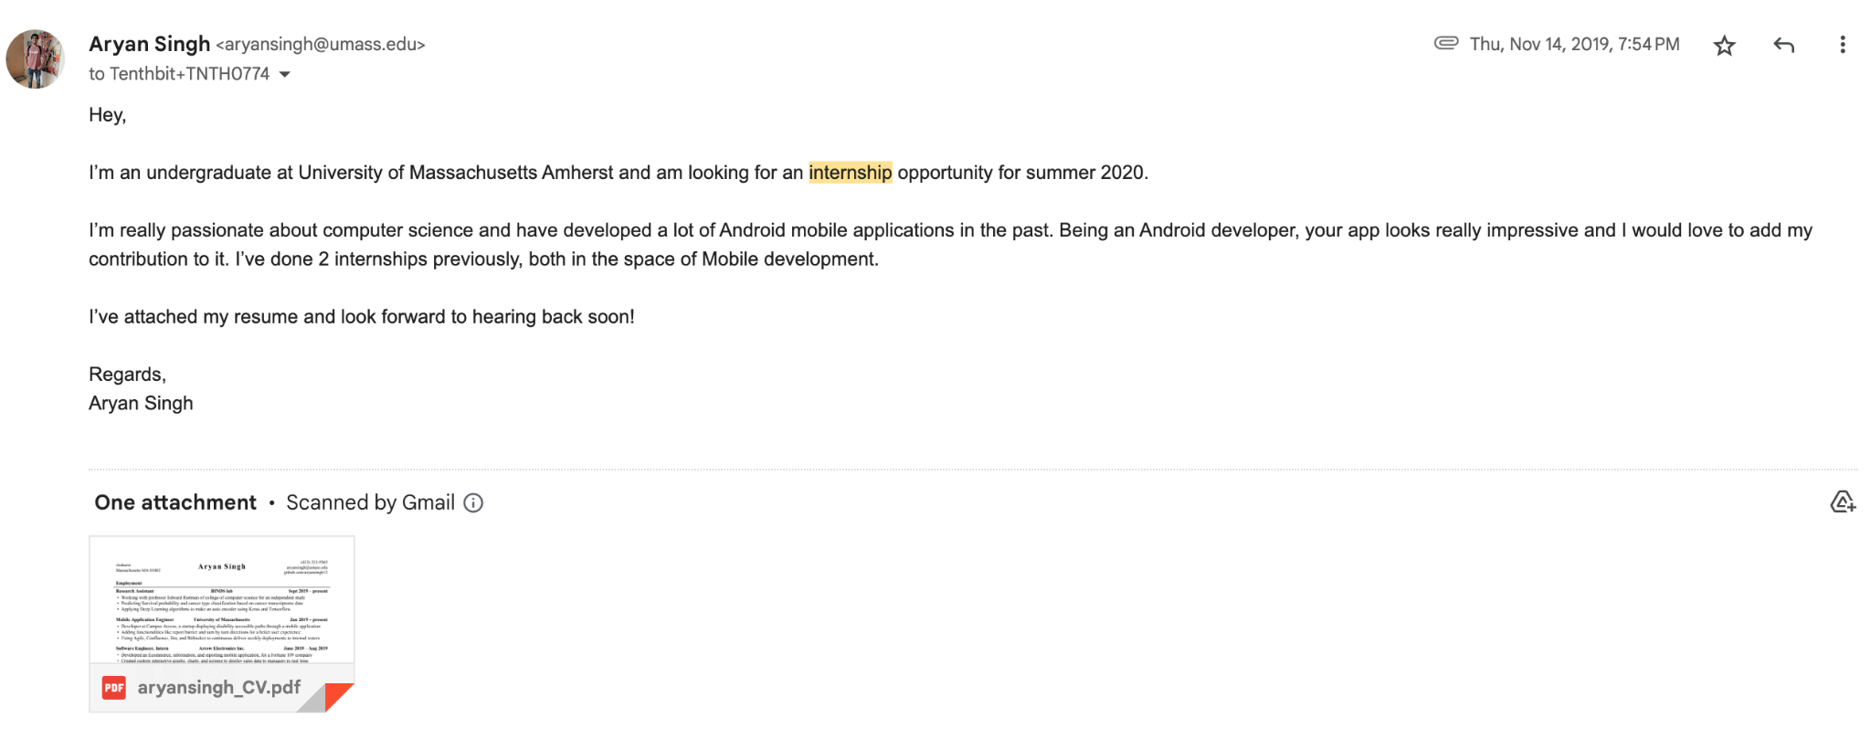
Don’t make it TOOOOO SIMPLE.
This is v simple and boring.
No links, github, portfolio, etc. BAD EMAIL

Slide 20
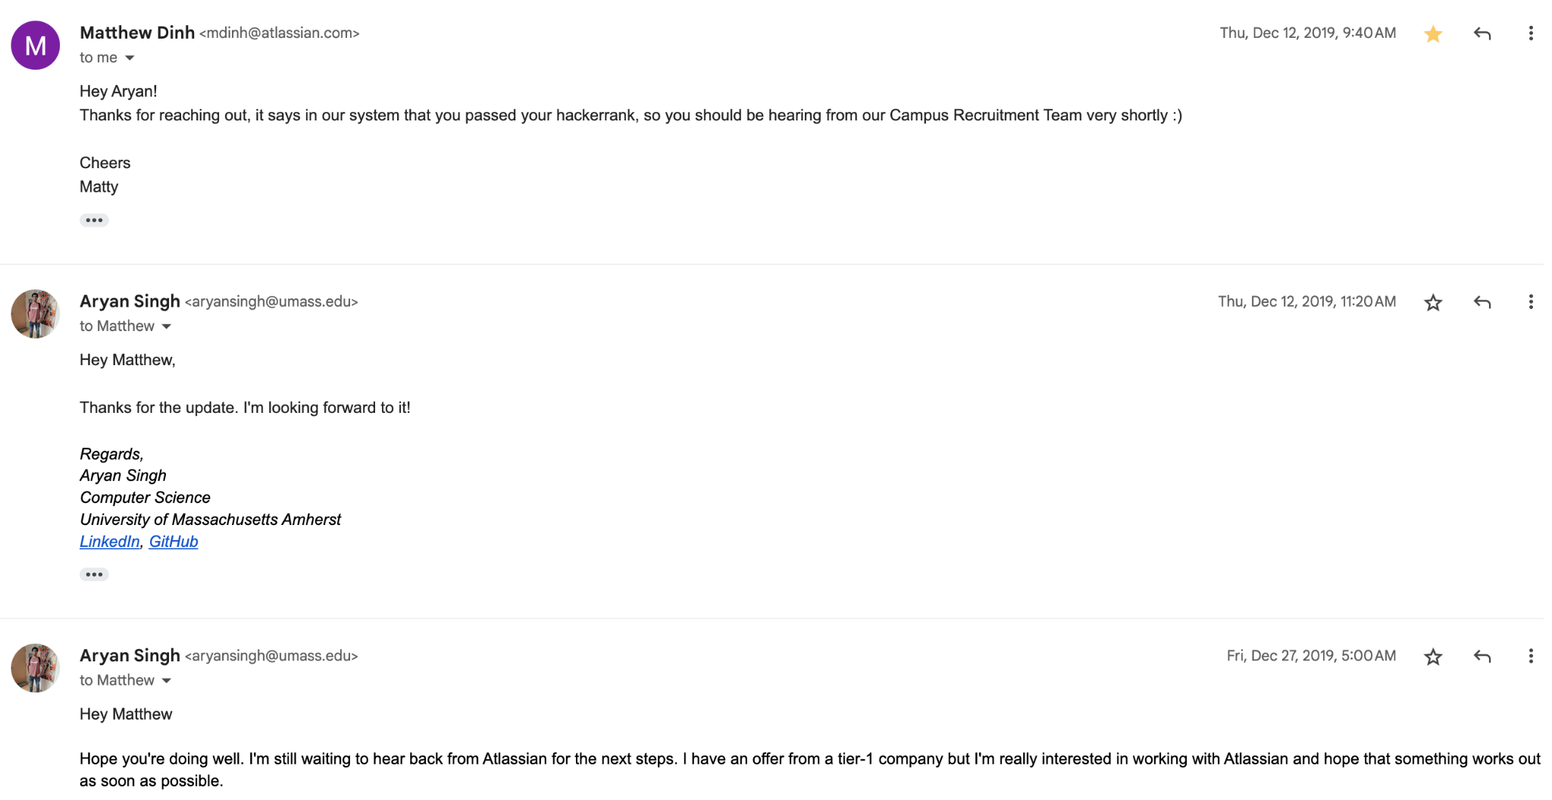
REGULAR FEEDBACK + TIMELINE

Slide 21
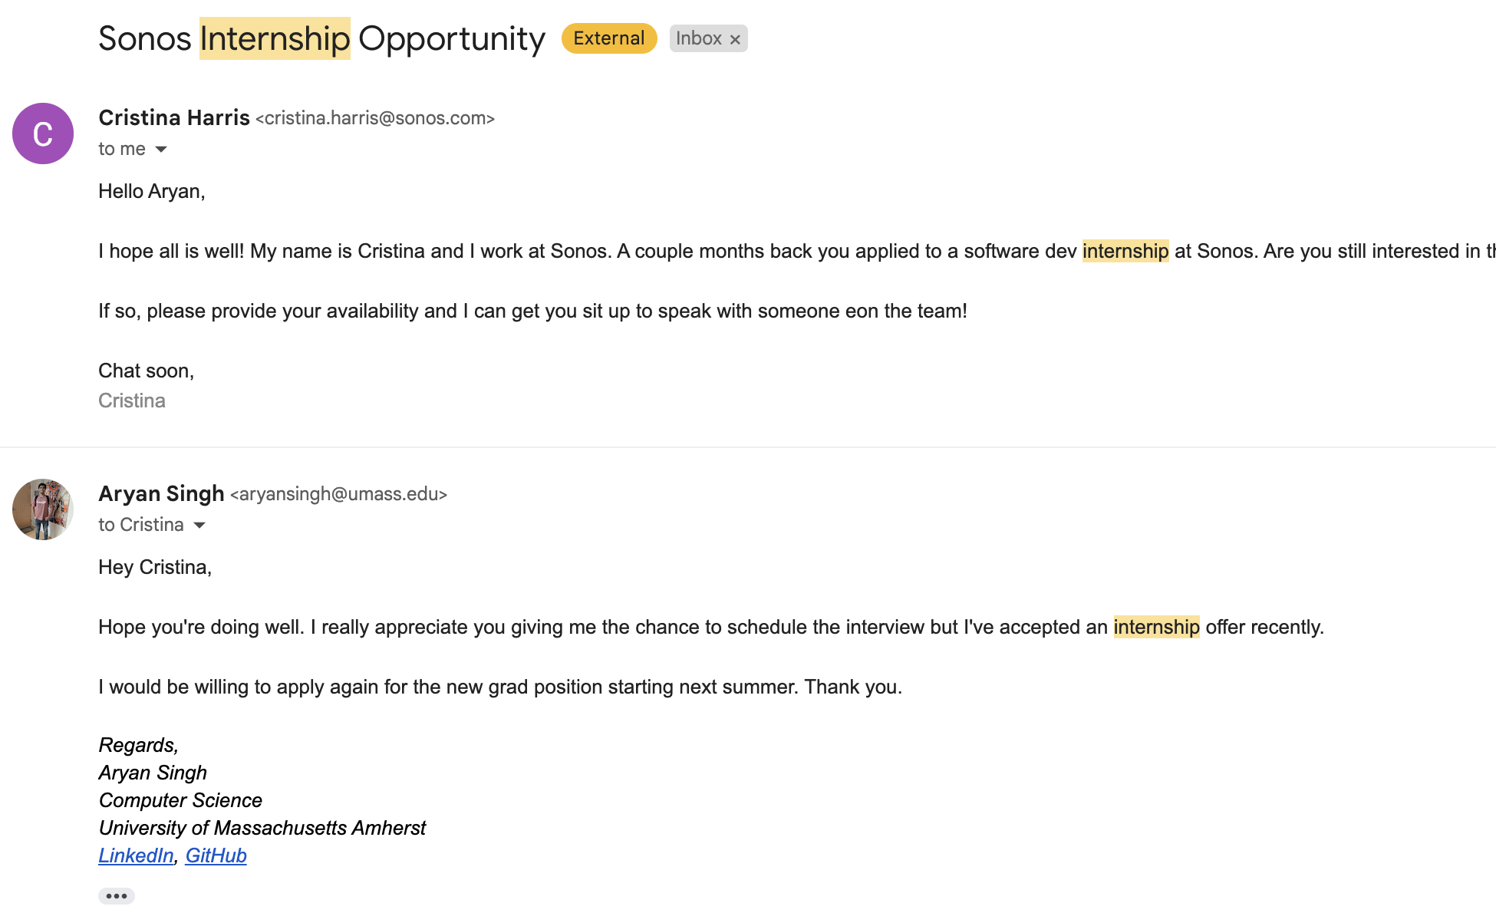
NEVER SAY NO
I said no to internship but still willing to get full time later
Never just say no
I had the google offer so said no
Always
Interview (never know about layoffs)
Ask for personal contact
Keep good relations
Never be rude
Never say no
Always reply even if you don’t ‘have’ to

Slide 22
Resources
https://www.30dayscoding.com/blogs/cold-email
Chat GPT
Try and test
Experiment
Be creative
Be unique
Find YOUR email and find your own journey
Don’t try to find the “BEST” email for you

Slide 23
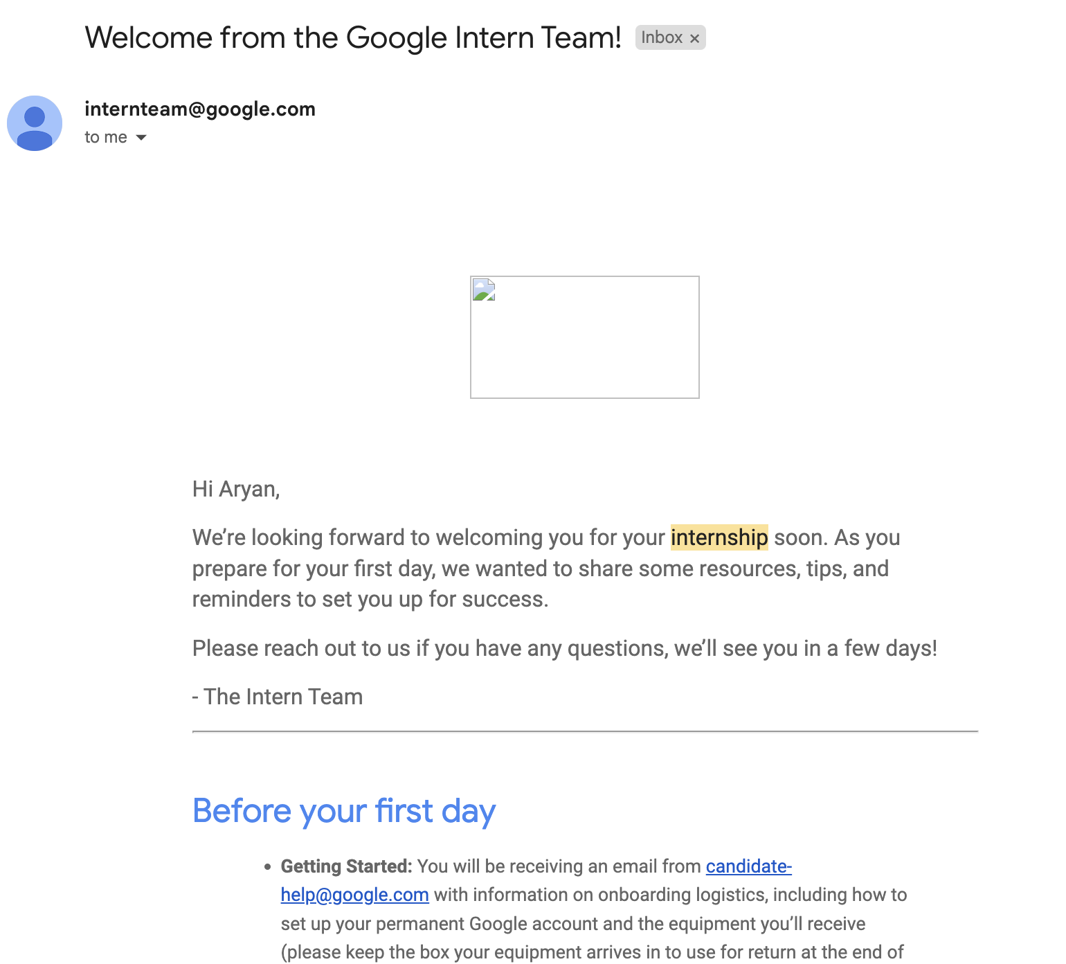
You will see this one day VERY VERY SOON!
Join the community: 30DaysCoding.com for $5/month
Free 1:1 with me
Free resources every week
Free events every week
Amazing people
Exclusive videos and courses

